Slide 1
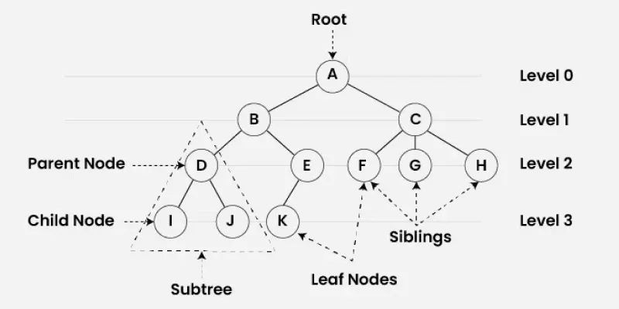
Tree
Tree Data Structure is a non-linear data structure and hierarchical data structure used to organize and represent data in a parent–child relationship. It consists of nodes, where the topmost node is called the root, and every other node can have one or more child nodes.

Slide 2
Importance of Tree Data Structure:
Trees are useful for storing data that naturally forms a hierarchy.
File systems on computers are structured as trees, with folders containing subfolders and files.
The DOM (Document Object Model) of an HTML page is a tree:The <html> tag is the root.<head> and <body> are its children.These tags can have their own child nodes, forming a hierarchical structure.
Trees help in efficient data organization and retrieval for hierarchical relationships.

Slide 3
Types of Tree Data Structures
Tree data structures can be classified based on the number of children each node can have.
Binary Tree:
Each node can have a maximum of two children.
Full Binary Tree – every node has either 0 or 2 children.
Complete Binary Tree – all levels are fully filled except possibly the last, which is filled from left to right.
Balanced Binary Tree – height difference between left and right subtrees of every node is minimal.

Slide 4
Ternary Tree:
Each node can have at most three children, often labeled as left, middle, and right.
N-ary Tree (or Generic Tree):
Each node can have any number of children.
Each node typically contains: Some data , A list of references to its children (duplicates are not allowed).
Unlike linked lists, nodes store references to multiple child nodes.

Slide 5
Basic Operations Of Tree Data Structure:
Create – create a tree in the data structure.
Insert − Inserts data in a tree.
Search − Searches specific data in a tree to check whether it is present or not.
Traversal: Preorder Inorder Postorder | A / \ B C / \ D E

Slide 6
Binary Search Tree (BST)
A Binary Search Tree follows:
Left subtree < Root
Right subtree > Root

Slide 7
Graphs
A Graph is a non-linear data structure consisting of a set of vertices (nodes) and edges that connect pairs of vertices.
A graph is represented as: G=(V,E)
where:
V = Set of Vertices (Nodes)
E = Set of Edges

Slide 8
Fundamental Terminology
Adjacent Vertices: Two vertices connected directly by an edge.
Degree of a Vertex: Total number of edges connected to a vertex.
In-degree (Directed Graphs): Number of incoming edges.
Out-degree (Directed Graphs): Number of outgoing edges.
Path: A sequence of vertices where each adjacent pair is connected by an edge.
Cycle: A path that starts and ends at the same vertex with no repeated edges.
Self-Loop: An edge that connects a vertex to itself.
Parallel Edges: Two or more edges connecting the same pair of vertices.
Simple Graph: A graph with no self-loops or parallel edges.
Connected Graph (Undirected): A graph where a path exists between every pair of vertices.
Strongly Connected (Directed): Every vertex is reachable from every other vertex.
Weakly Connected (Directed): Connected when direction of edges is ignored.

Slide 9
Graph Classification
Graph Type | Description
Undirected | Edges have no direction; (u, v) = (v, u).
Directed (Digraph) | Edges have direction; (u, v) != (v, u)
Weighted | Edges carry numerical values (weights/costs/distances).
Unweighted | All edges have equal weight (usually considered 1).
Cyclic / Acyclic | Contains cycles / contains no cycles.
DAG (Directed Acyclic Graph) | Directed graph with no directed cycles (used in scheduling/dependencies).

Slide 10
Graph Storage Representations
The two most common ways to represent a graph in computer memory are Adjacency Matrix and Adjacency List.
A. Adjacency Matrix
A 2D array A of size V * V, where A[i][j] = 1 (or edge weight) if an edge exists from vertex i to vertex j, and 0 otherwise.

Slide 11
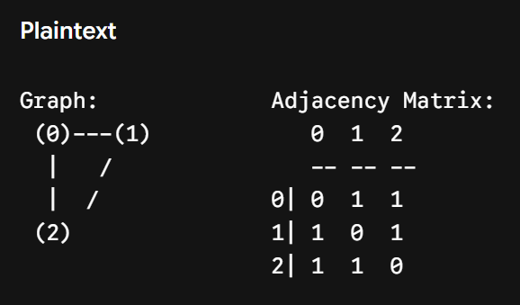
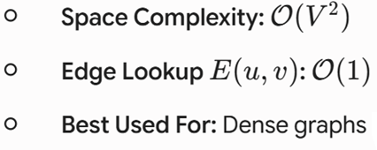
Adjacency Matrix

Slide 12
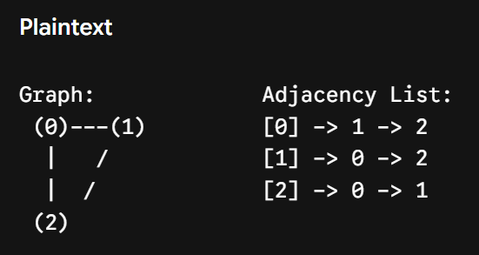
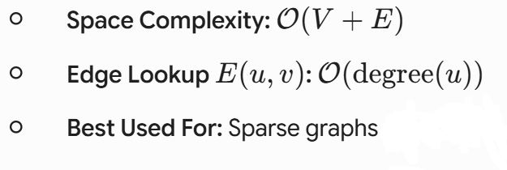
Adjacency List
An array or dynamic list of size V, where each index i stores a linked list/vector of adjacent vertices.

Slide 13
Graph Traversals A. Breadth-First Search (BFS)
Strategy: Explores vertices level-by-level starting from a source node using a Queue (FIFO) data structure.
Use Cases: Shortest path in unweighted graphs, finding connected components.
Time Complexity: O(V + E)
Space Complexity: O(V)

Slide 14
B. Depth-First Search (DFS)
Strategy: Explores as deep as possible along each branch before backtracking, using a Stack (LIFO) or recursion.
Use Cases: Cycle detection, topological sorting, solving mazes.
Time Complexity: O(V + E)
Space Complexity: O(V)

Slide 15
